Slide 1

PROJETO DE SIRS 23/24
BOMB APPETIT
RESTAURANT APP
SECURE AND RELIABLE COMMUNICATION
REALIZED BY:
LUÍS MARQUES Nº 99265
RAMIRO MOLDES Nº 99313

Slide 2





OBJECTIVES
By the end of this presentation , students will be able to:
How the Infrastructure was designed
How was configured the security of the connections and key distribuition
How it was hadled the security challenge
Conclusion, mishaps and realizations of what was done
How The Document was Secured

Slide 3
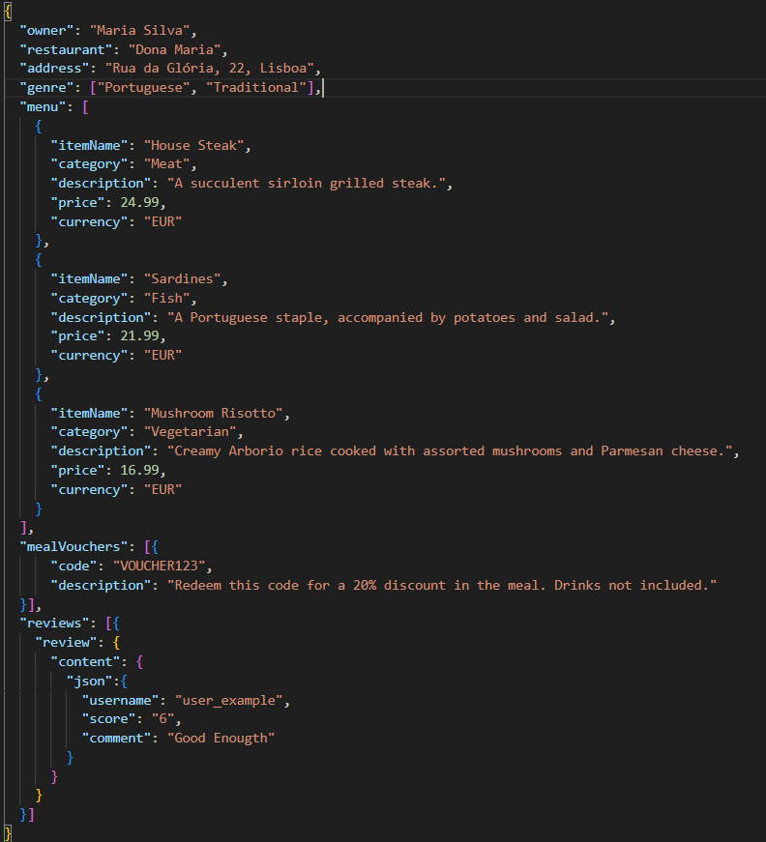
DOCUMENT EXAMPLE

Slide 4



SECURITY IMPLEMENTED
Confidentiality
Freshness
Authenticity and Integrity
AES-256 sym key
Timestamp
PKCS #1 v1.5
CBC Mode
Nonce
RSA Asym key
IV
SHA- 256 hashing
Base 64 encoding

Slide 5
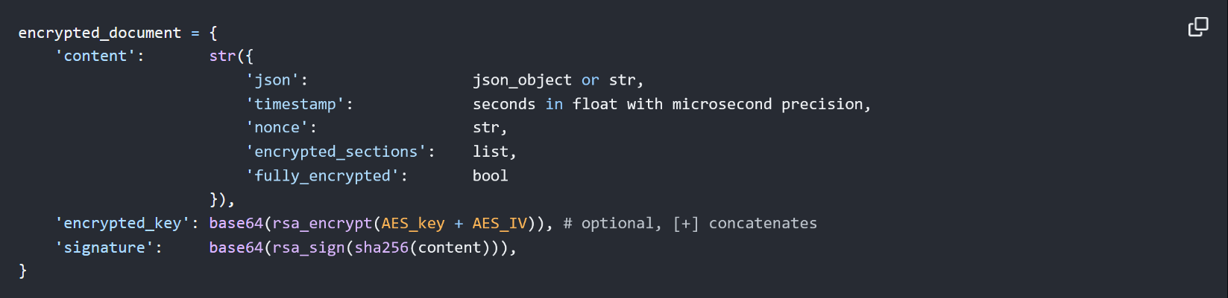
SECURE DOCUMENT FORMAT

Slide 6




SECURITY
OF
CONNECTIONS
&
KEY DESTRIBUTION
TLS
Same client key and certificate for connections
Shared Server certificate and server public key
Client share public key to server
SSH
Server knows credentials of database
Database stores clients public keys
Database configured with a selected ip

Slide 7
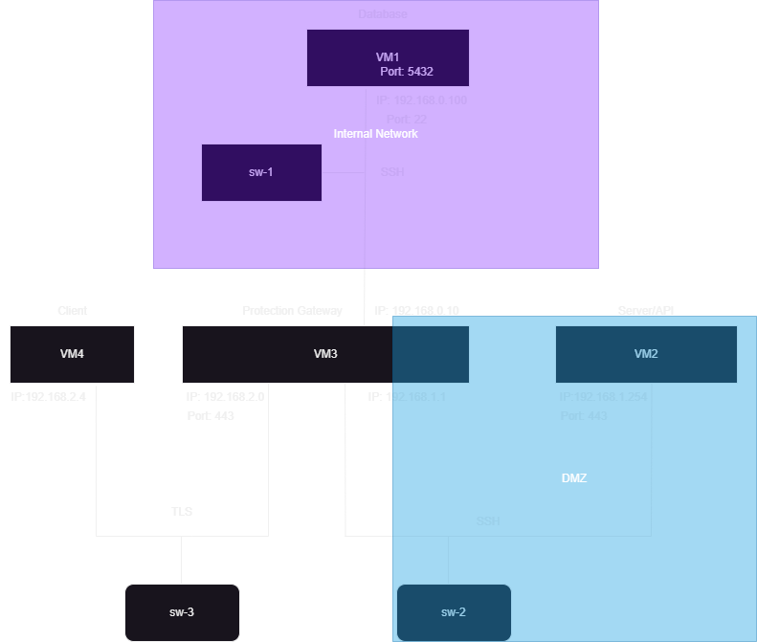
INFRASTRUCTURE & FIREWALLS

Slide 8

SECURITY CHALLENGE
Review is his own json
Executing signing just for the review and store the json secure document on the database as the review
Encrypt function handles all matters of security of the document
Review added to the json file of the restaurant when read request is made
Verify review by getting all public keys stores in the database
Freshness is not verified for the review

Slide 9

MAIN RESULT & CONCLUSIONS
Constructed the entire infrastructure for a simple service
Maintained and fortified the machines
Designed and connected the network layout
Secured connections with off-the-shelf solutions
Created customized protocols for added restrictions and assurance
Validated each message for security
While meeting most requirements, some aspects fell short, notably the user experience's simplicity and the server's minimal error handling for multi-user interactions

Slide 10

PRESENTED BY LUÍS MARQUES Nº 99265 & RAMIRO MOLDES Nº 99313
THANK YOU VERY MUCH!

